Slide 1
Simulation of thin film growth
Shawn Wimer
4/19/2024

Slide 2
Contents
Growth equations
Molecular dynamics
Ballistic deposition
Monte Carlo method

Slide 3

Thin film growth models
Use very general models to describe the interface with the volume above the surface
Simple model: the surface grows at a constant rate perpendicular to the surface at all points
Surface roughness increases until islands begin coalescing, then decreases
Growth equations

Slide 4

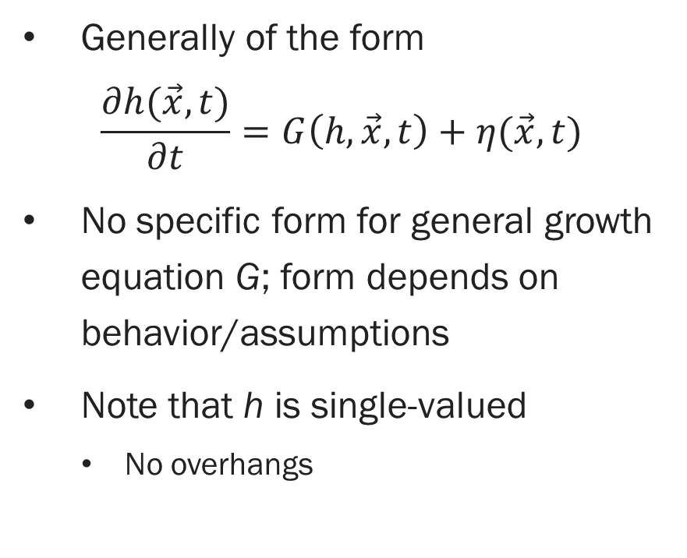
Growth equations
Describable by h
Generally of the form $\frac{∂h(\vec{x},t)}{∂t}=G\left(h, \vec{x}, t\right)+η(\vec{x}, t)$
No specific form for general growth equation G; form depends on behavior/assumptions
Note that h is single-valued
No overhangs
Not describable by h
Growth equations

Slide 5
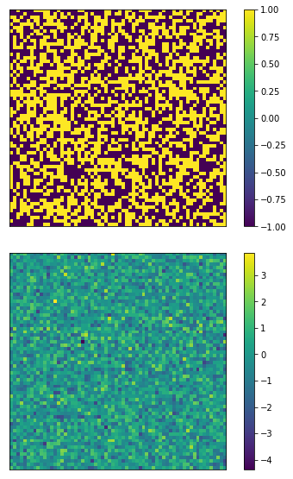
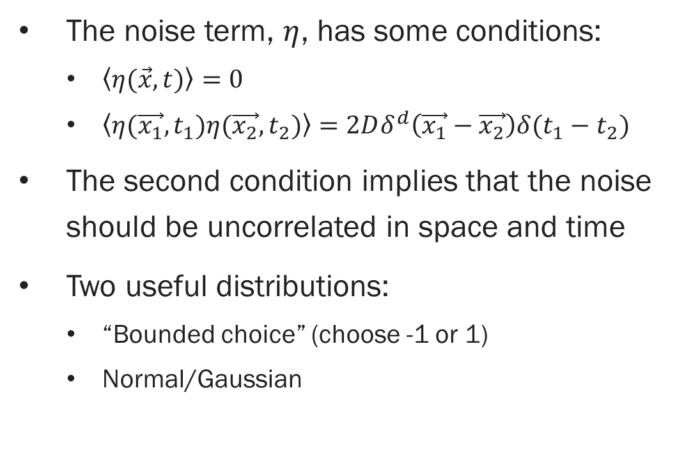

Noise term: $η(\vec{x}, t)$
The noise term, $η$, has some conditions:
$\left\langle η(\vec{x}, t)\right\rangle =0$
$\left\langle η(\vec{x_{1}}, t_{1})η(\vec{x_{2}}, t_{2})\right\rangle =2Dδ^{d}\left(\vec{x_{1}}−\vec{x_{2}}\right)δ(t_{1}−t_{2})$
The second condition implies that the noise should be uncorrelated in space and time
Two useful distributions:
“Bounded choice” (choose -1 or 1)
Normal/Gaussian
Growth equations

Slide 6
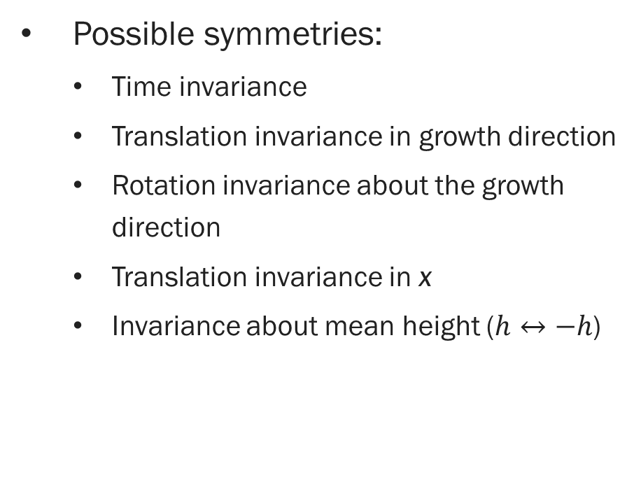
Determine G
G is normally a differential equation, possibly non-linear
Hard way: solve for it knowing desired behavior
Easier way: reason towards it
Symmetries in the behavior lead to certain differential terms being excluded in G
Possible symmetries:
Time invariance
Translation invariance in growth direction
Rotation invariance about the growth direction
Translation invariance in x
Invariance about mean height ($h↔−h$)
Growth equations

Slide 7
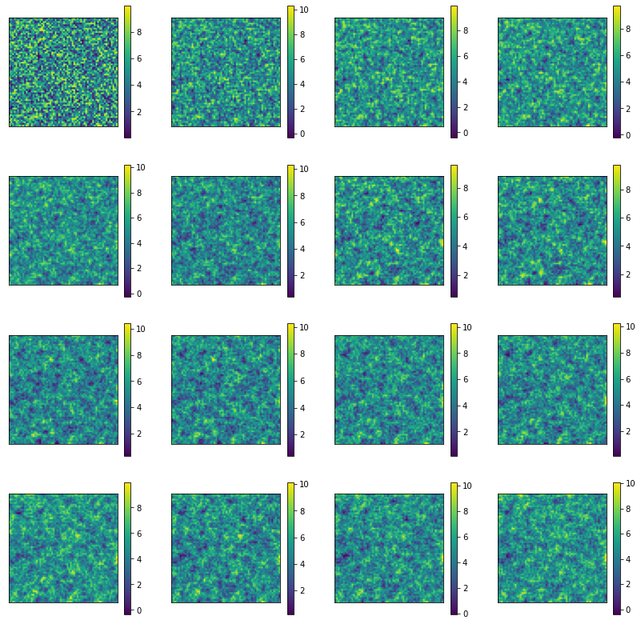
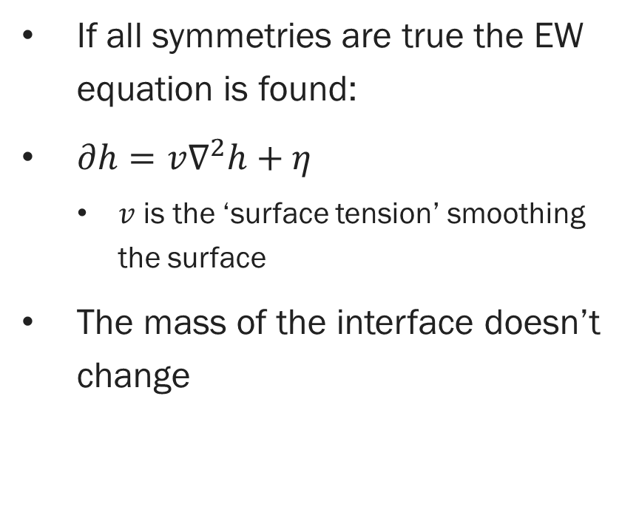
Edwards-Wilkinson equation
If all symmetries are true the EW equation is found:
$∂h=v∇^{2}h+η$
$v$ is the ‘surface tension’ smoothing the surface
The mass of the interface doesn’t change
Growth equations

Slide 8
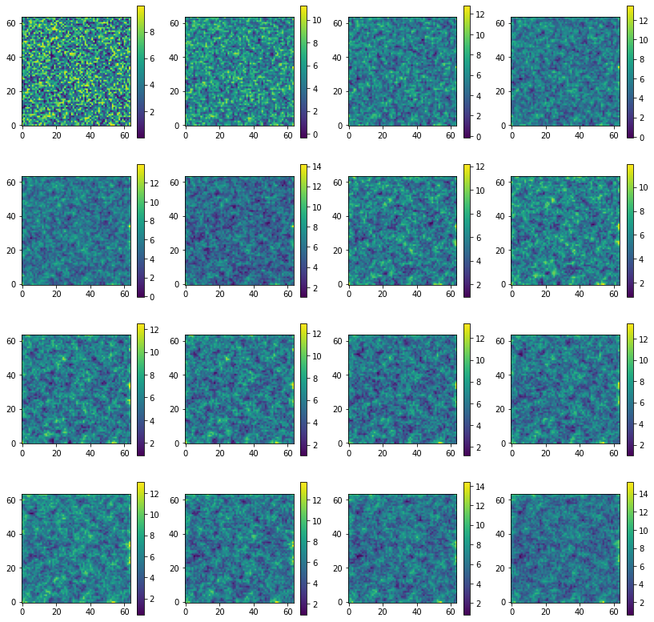
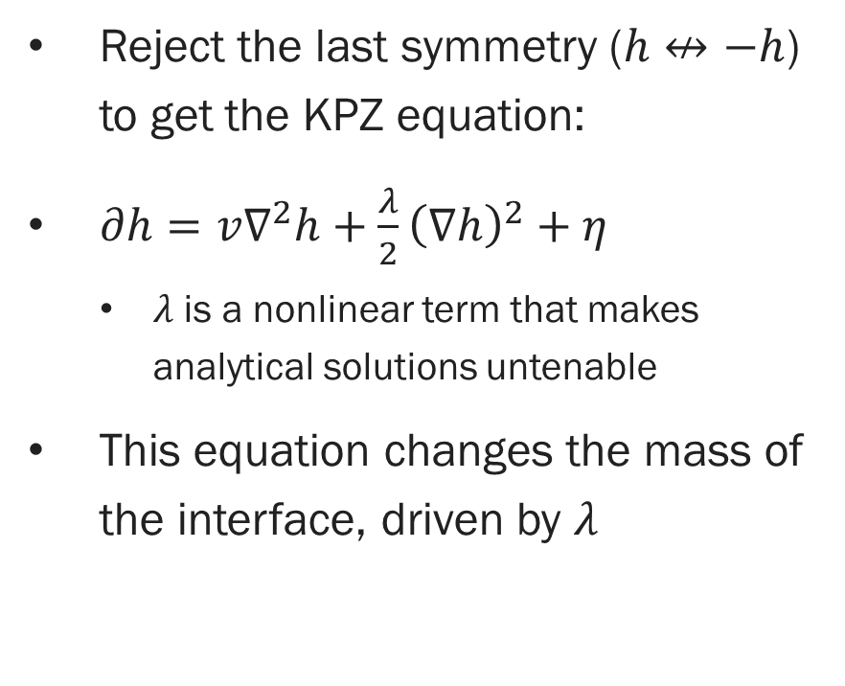
Kardar-Parisi-Zhang equation
Reject the last symmetry ($h↮−h$) to get the KPZ equation:
$∂h=v∇^{2}h+\frac{λ}{2}{\left(∇h\right)}^{2}+η$
$λ$ is a nonlinear term that makes analytical solutions untenable
This equation changes the mass of the interface, driven by $λ$
Growth equations

Slide 9
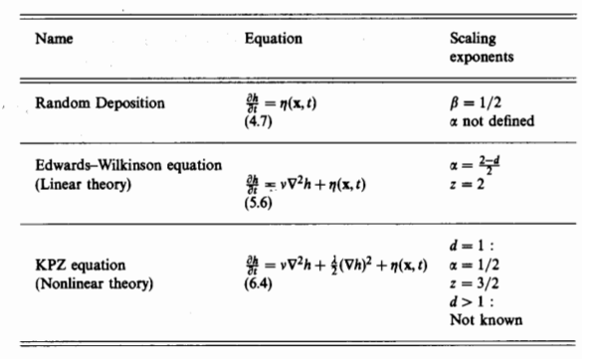
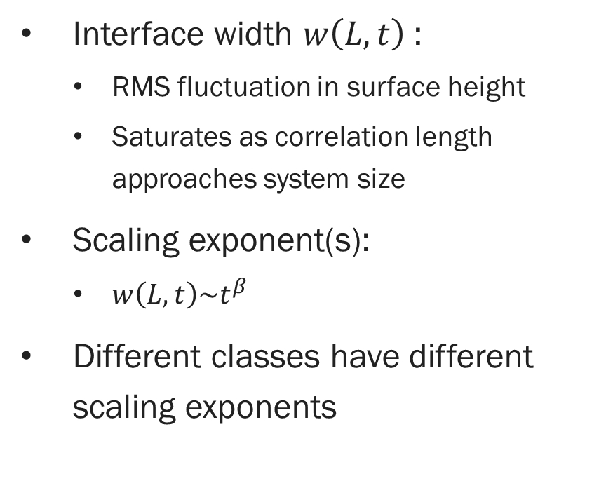
Scaling exponent
Interface width $w\left(L,t\right)$:
RMS fluctuation in surface height
Saturates as correlation length approaches system size
Scaling exponent(s):
$w\left(L,t\right)\sim t^{β}$
Different classes have different scaling exponents
Barabasi and Stanley, 1995 [1]
Growth equations

Slide 10
Application of growth equations
Many different growth classes have been studied
KPZ describes a well-studied universal class
Often no analytical solutions
Use numerical techniques, but:
Depends on space and time step sizes
Much harder when spatial correlations play a heavy role
No information on the lattice or individual particles
Normally: simulate another way and compare to equations
Another simulation method is needed:
Let’s try simulating the process rather than the model
Growth equations

Slide 11
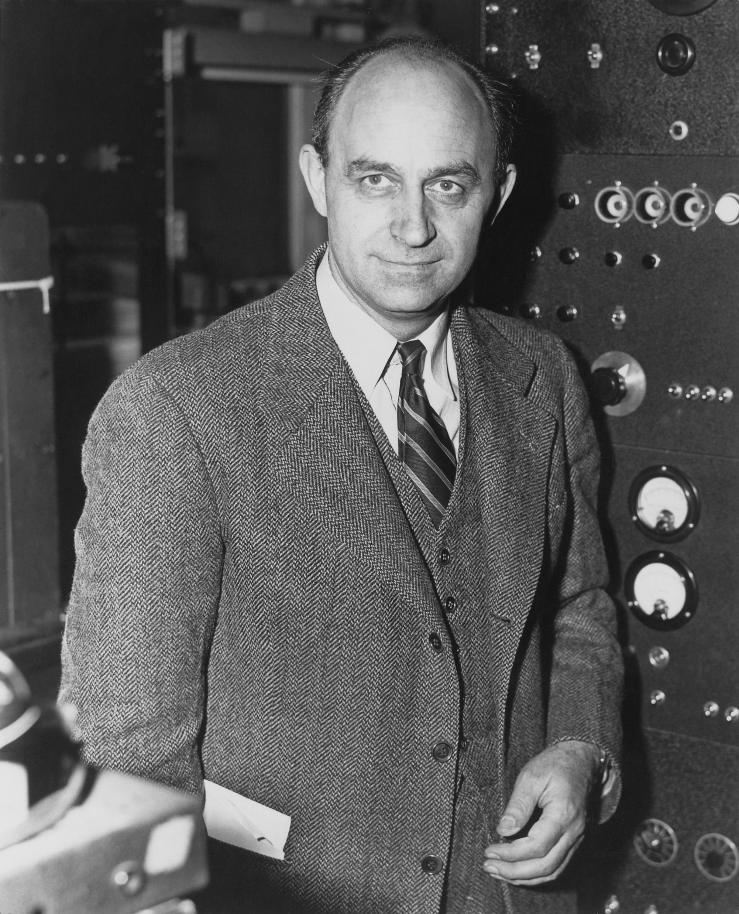
Molecular dynamics
Enrico Fermi
(DOE)

Slide 12
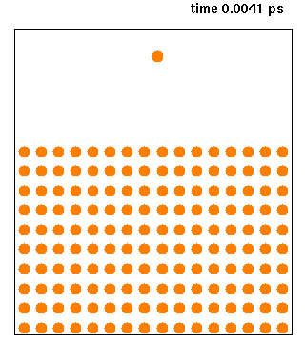
Molecular dynamics
Simulate the behavior of particles by implementing physical laws
Simulate how particles move according to the forces between them
Increasingly used in biology
Protein shapes and interactions
Knordlun on Wikipedia
Molecular dynamics

Slide 13
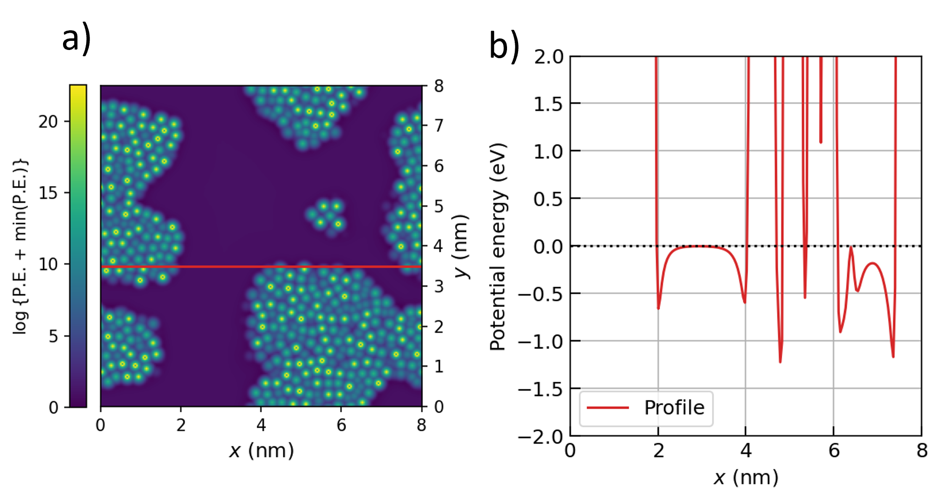
Using potentials
Create ‘force fields’ to model the forces between molecules
Apply them by Newtonian mechanics
Can use quantum mechanics
Many possible potentials, including analytical and calculated
Choice depends on application
Molecular dynamics

Slide 14
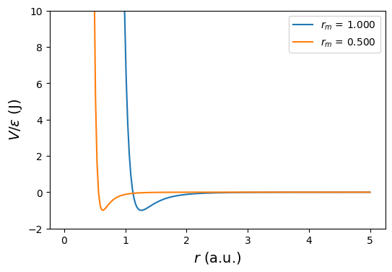
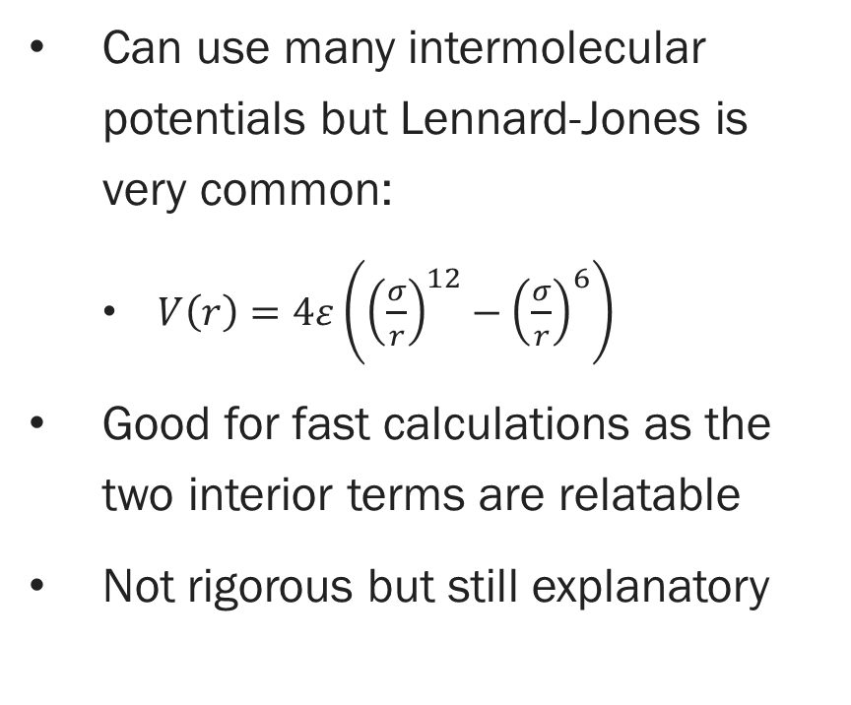
Potentials and forces
Can use many intermolecular potentials but Lennard-Jones is very common:
$V\left(r\right)=4ε\left({\left(\frac{σ}{r}\right)}^{12}−{\left(\frac{σ}{r}\right)}^{6}\right)$
Good for fast calculations as the two interior terms are relatable
Not rigorous but still explanatory
Molecular dynamics

Slide 15
Application to film growth
Bad computational scaling with increasing particles
Multi-body effects
Dependence on time step
Very short time scales
Answer: increase your computational resources or simplify the processes (or both)
More computational power:
Expensive
Power scales slower than the problem
Simplification:
Less realistic
Less intuitive
At this point, consider another method
Let’s try abstracting the process
Molecular dynamics

Slide 16
Ballistic deposition

Slide 17
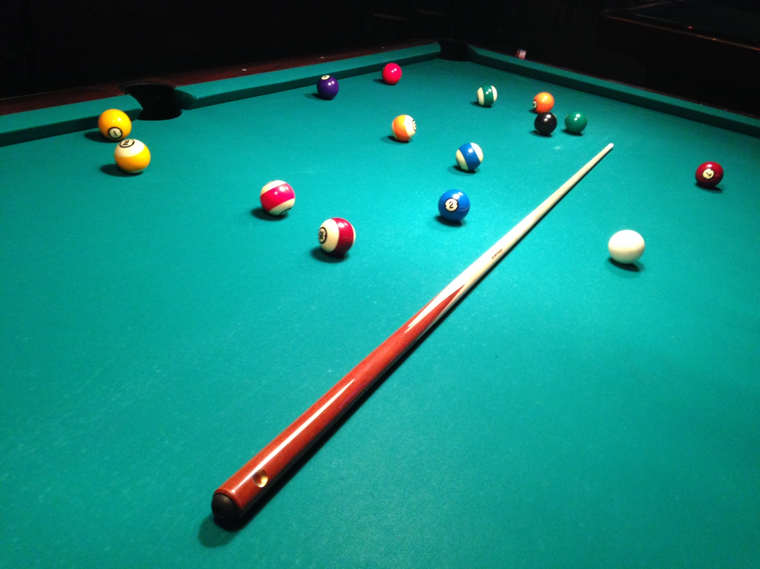
Ballistic deposition
Model individual particles as objects that collide with a surface
Developed to simulate sedimentation and aggregation in solution in 1950s/1960s
Later applied to vapor deposition simulations
Often described by KPZ equation
Commonly likened to billiards, where spherical hard objects physically collide with each other and their confines
Ballistic deposition

Slide 18
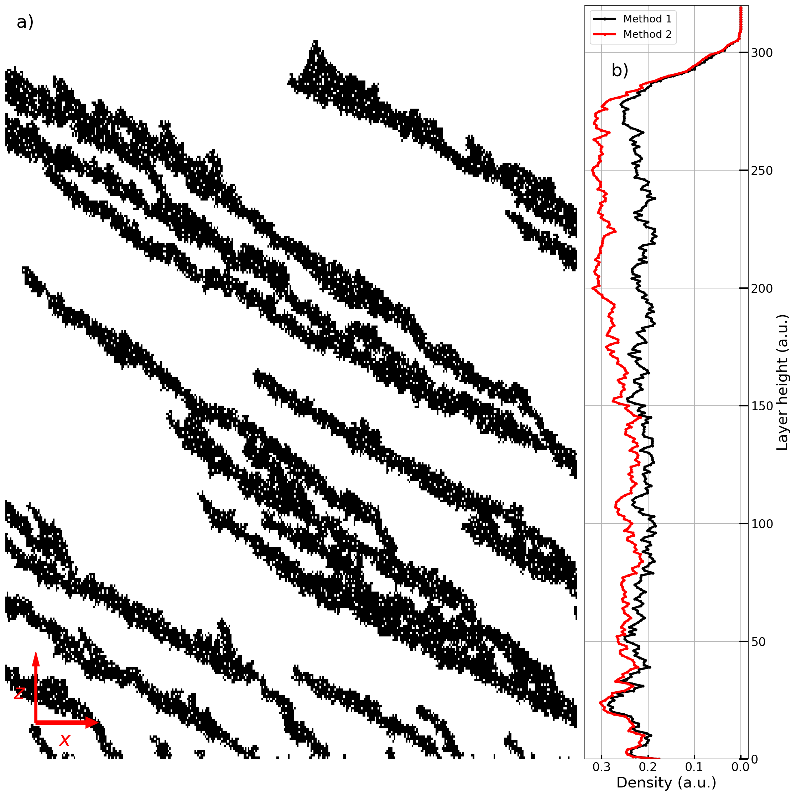
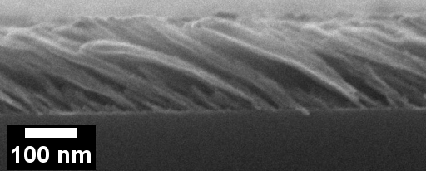
Film features
Very porous and low-density
Rough with high surface area
Substrate tilt leads to individual structures similar to each other and self-similar (‘fractal-like’)
Ballistic deposition

Slide 19
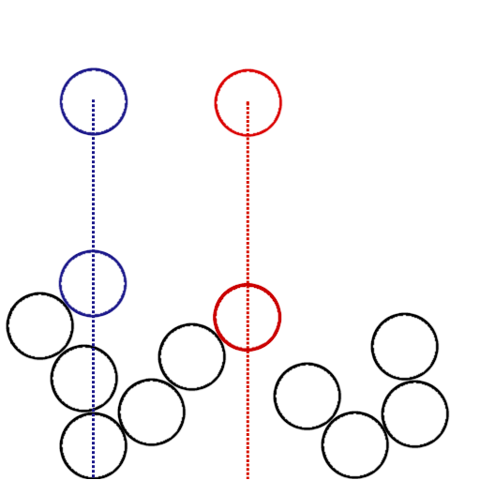
Simple ballistic deposition model
Create a 2D simulation area with a substrate along the bottom
Drop spheres one-by-one at random positions high above the substrate
Stick them where they land
Optionally, let each settle/relax/diffuse after it lands
Ballistic deposition

Slide 20
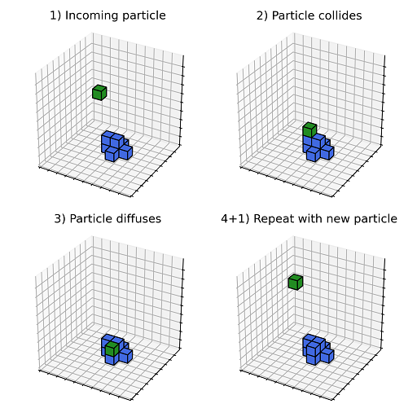
On-lattice/off-lattice or discrete-/continuous-space
Simulations can take place in discrete- or continuous-space
On-lattice and off-lattice, respectively
Discrete-space easier and faster but requires some assumptions
Imposition of lattice
Shape of particle
Most use discrete-space but early work was all continuous space
Ballistic deposition

Slide 21
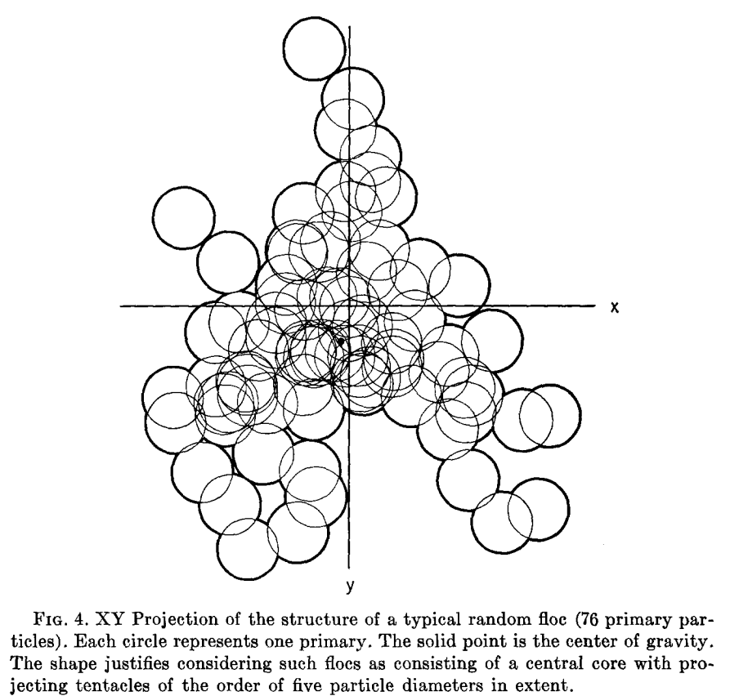
Random variables
(Probably) universally assume uniform distribution of incoming particle position
Particles can be modeled with an angular distribution
Be careful to use it correctly
Diffusion can be randomized
Monte Carlo methods are useful here
Vold 1963 [2]
Ballistic deposition

Slide 22
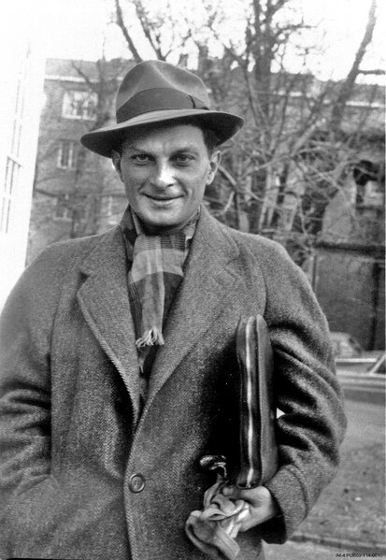
Monte Carlo method
Stansilaw Ulam (Los Alamos National Laboratory)

Slide 23
Monte Carlo method basics
Use repeated random sampling to collect aggregate results
Useful for determining numerically what is difficult analytically
Large numbers of sampling are generally better, so computers are useful
Procedure:
Determine the range of potential inputs
Draw samples from the range of inputs
Process the samples according to the model being analyzed
Record the individual and/or aggregate results
Monte Carlo method

Slide 24
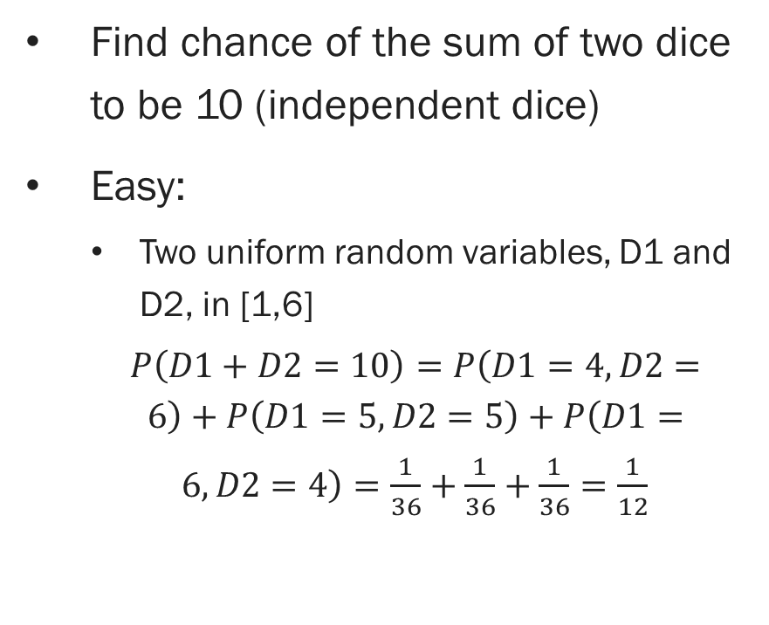
Counter example: Sum of dice
Find chance of the sum of two dice to be 10 (independent dice)
Easy:
Two uniform random variables, D1 and D2, in [1,6]
$P\left(D1+D2=10\right)=P\left(D1=4,D2=6\right)+P\left(D1=5,D2=5\right)+P\left(D1=6,D2=4\right)=\frac{1}{36}+\frac{1}{36}+\frac{1}{36}=\frac{1}{12}$
Easily extended to find the chance of any possible sum
Just count the individual probabilities and sum them
Monte Carlo method not necessary here
Monte Carlo method

Slide 25
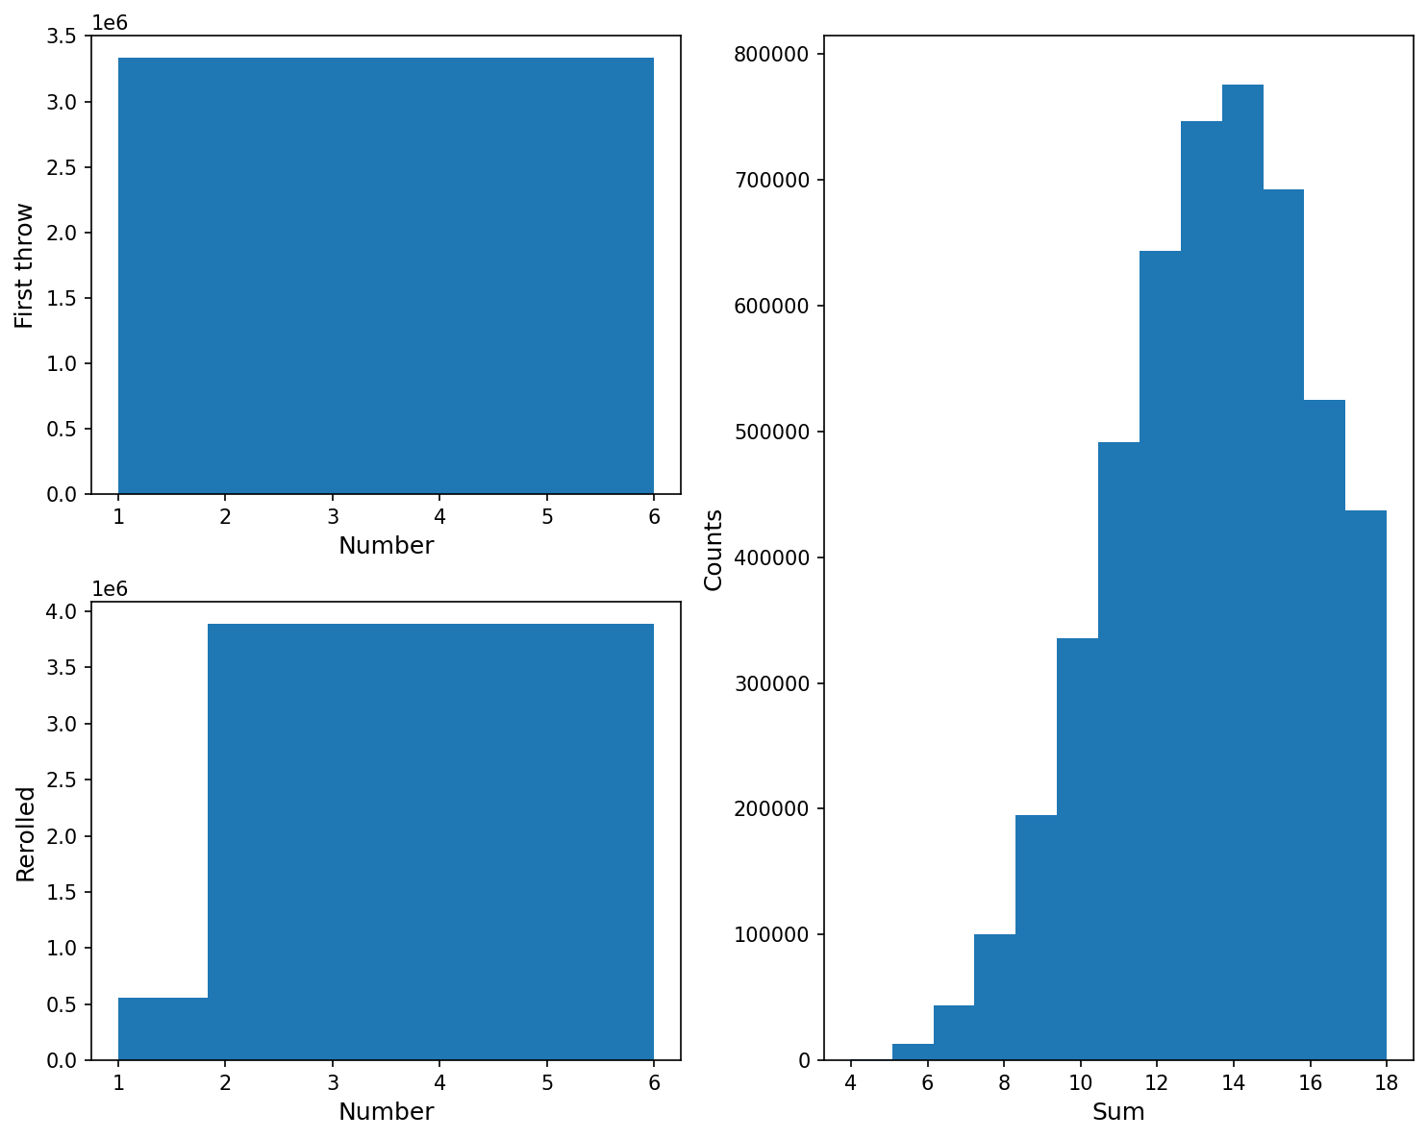
Example: Complicated sum of dice
Roll four dice, reroll any 1s on the first throw, then sum the three largest:
[4, 4, 1, 1] -> [4, 4, 2, 1] -> 10
Much more complicated to figure out analytically
Monte Carlo method

Slide 26
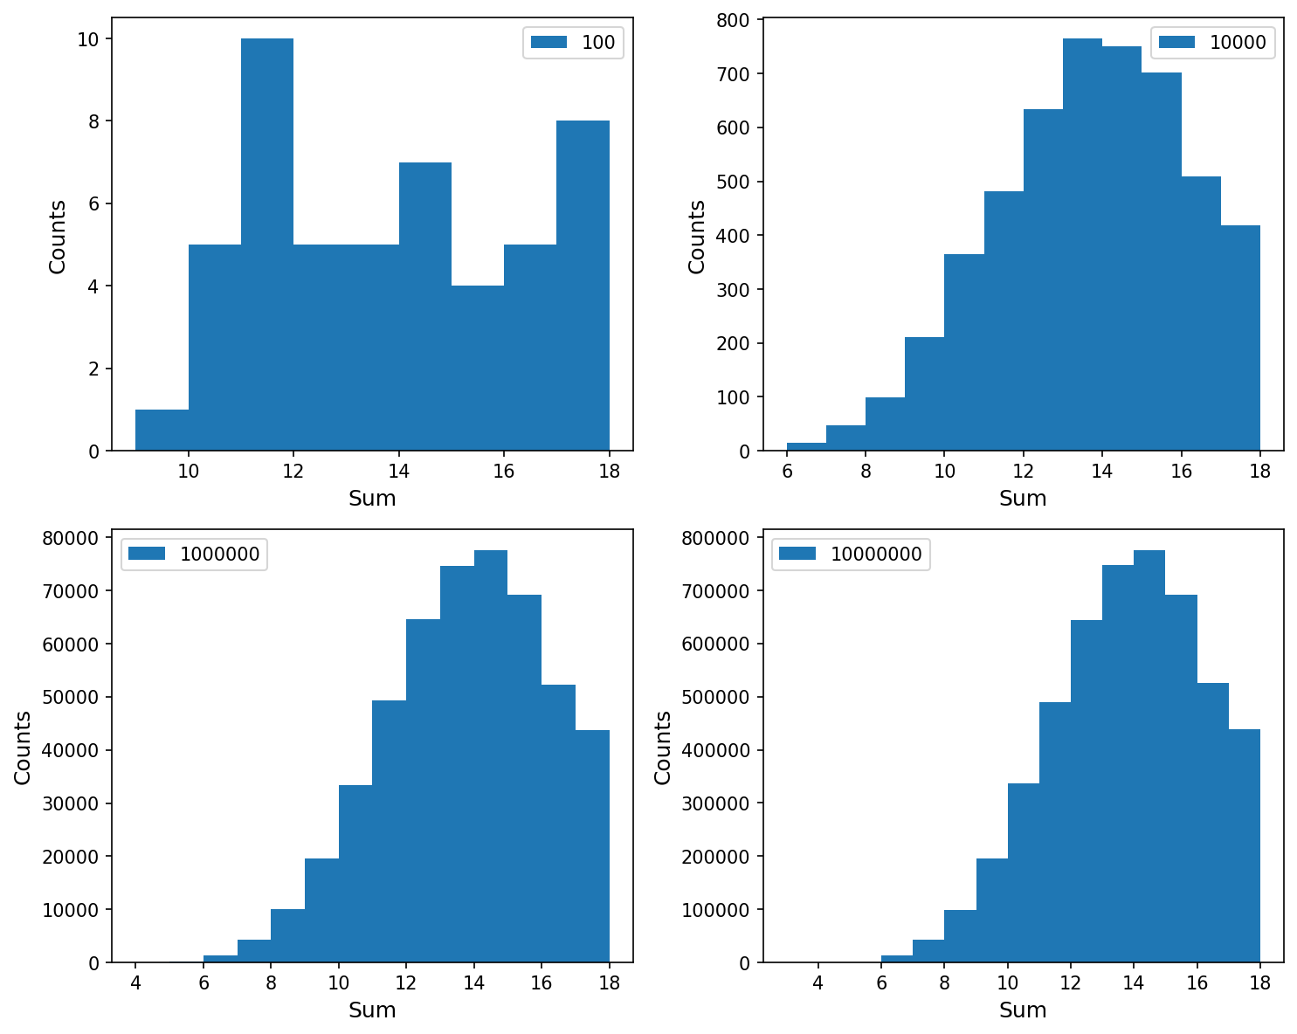
Example: Complicated sum of dice
The quality of the results depends on the number of samples
More complicated processes might require many more samples, particularly to find the ends of the range
Monte Carlo method

Slide 27
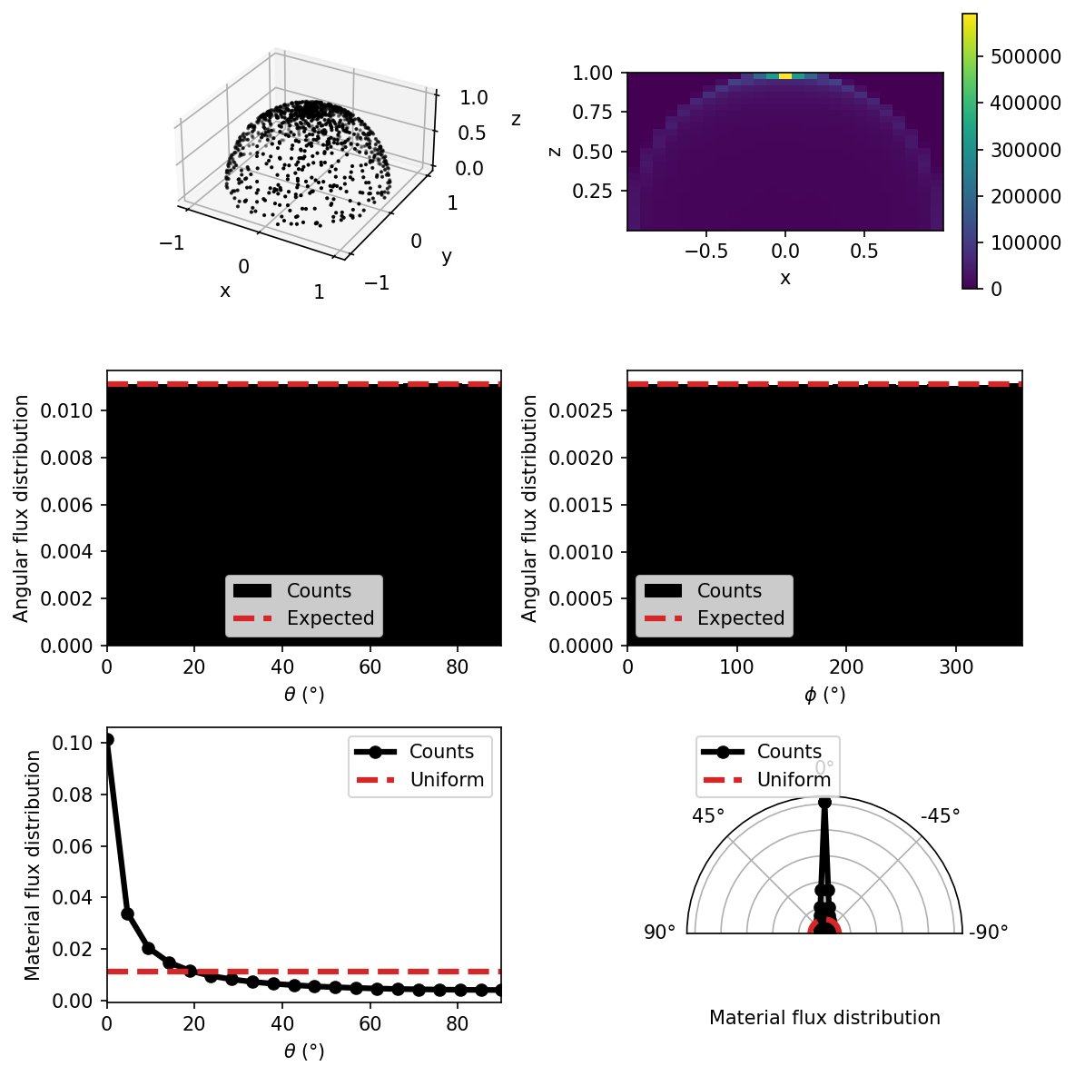
Monte Carlo considerations
Correctly sample the correct distribution!
Some advanced techniques exist to sample more complicated distributions
Increasingly used wherever statistics are useful
Particle physics, finance, operations, etc.
Monte Carlo method

Slide 28
Conclusion
Growth equations
Molecular dynamics
Ballistic deposition
Good:
Well-studied equations
Bad:
No overhangs
No exact solution
Time-step dependence
Good:
Directly apply physics
Tailorable to needs
Many mature methods
Bad:
Slow; scales poorly
Time-step dependence
Good:
Fast
Easily created
Simple
Bad:
Same problems as MD or discretized
Time is arbitrary
Conclusion

Slide 29
Bibliography
Barabasi and Stanley, “Fractal Concepts In Surface Growth”, Cambridge University Press (1995)
Marjorie Vold, “Computer simulation of floc formation in a colloidal suspension”, 1963, Journal of Colloid Science 18, 684-695 (1963)

